Slide 1
QUE 101 ~ WELCOME

Slide 2
We Are QUE
Welcome to the QUE
We have a Learning Culture where Knowledge is Empowerment.
To share what your have learned ~ QUE Forward
Que Forward leads to Leadership
Leadership is a major contributor to career advancement

Slide 3
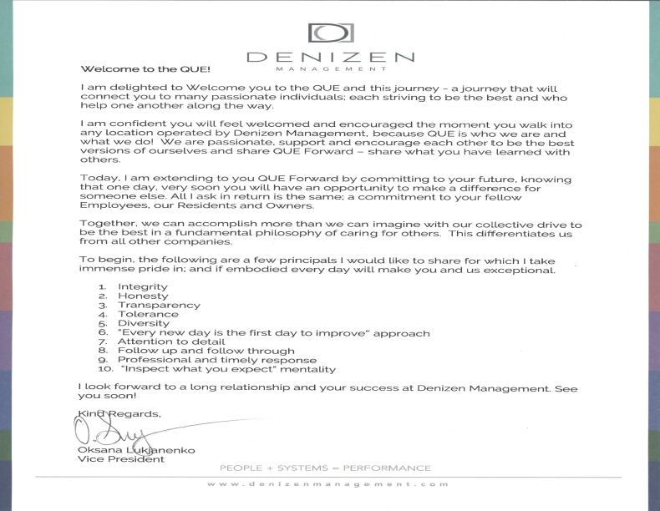
Welcome to the QUE
Integrity
Honesty
Transparency
Tolerance
Diversity
“Every new day is the first day to improve” approach
Attention to detail
Follow up and follow through
Professional and timely response
“Inspect what you expect” mentality
Notes:
READ OKSANAS LETTER

Slide 4
Our History
Wanted to serve Residents and the Denizen QUE concept was born ~ The Resident Experience.
Customer Service is the foundation of Denizen Management
Denizen Management and DenizenQUE founded on September 3, 2012
Denizen Management and DenizenQUE merged companies rebranded as Denizen Management January 1, 2016
Notes:
Today, the Company we know serves three equally important constituencies; Owners, Employees (our People) and Residents; is steeped in its We Are QUE culture; and expanding every year with new Owners, services to our Residents and career opportunities for our People.

Slide 5
We are QUE
Quality Service Quotients (“QSQ”) reinforce our Culture and we train our People utilizing Eight (8) Modules in the advancement of our QUALITY, UNIQUE and EXECPTIONAL customer service, The Resident Experience
Through the Leadership of our Experienced Team we listen, learn and understand our Owner goals and objectives, provide honest advice.

Slide 6
Quality Service Quotients (QSQ)
A list of Fundamental Principles to achieve the most consistent and highest quality of customer service
When followed by every Employee, the Company’s service goals will be achieved, and Owner expectations met.
The QSQs are divided into three categories which represent the three constituencies of Company; Residents, Employees and Owners
Together they are an integral part of the We Are QUE and denizenQUE culture and philosophy.
Notes:
Pgs 6-7
Quality Service Quotients (“QSQ”) are a list of Fundamental Principles to achieve the most consistent and highest quality of customer service. They are the basic list of daily reminders (“to dos”). When followed by every Employee, the Company’s service goals will be achieved and Owner expectations met.
The QSQs are divided into three categories which represent the three constituencies of Company; Residents, Employees and Owners. Together they are an integral part of the We Are QUE and denizenQUE culture and philosophy.
QSQs are included in the QUE 101 (employee orientation) and embedded in the Company’s standard operating procedure Modules.

Slide 7
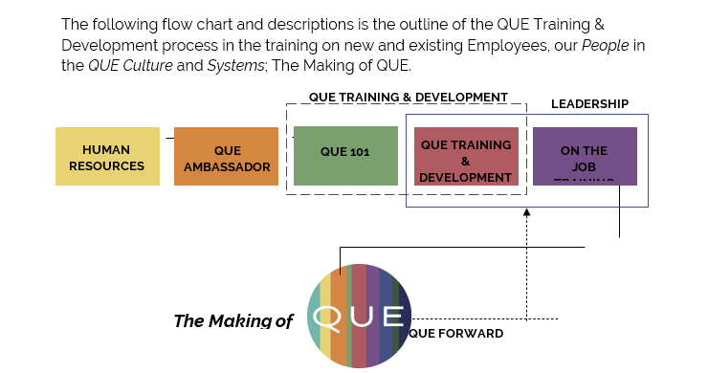
The Making of QUE
It begins by recruiting good People who like others, boarding them to Join The QUE and giving them the basic tools to begin their career, QUE 101.

Slide 8
Human Resources.
Que Ambassadors
QUE 101
QUE Training & Development
On The Job Training
Leadership
QUE Forward
Notes:
Human Resources
Human Resources is an essential part of QUE. It begins by advertising for and recruiting good People to Join The QUE. Then by interviewing and screening for qualifications, background and personality testing to select candidates who will best serve, thrive and advance with the Company
. Then by interviewing and screening for qualifications, background and personality testing to select candidates who will best serve, thrive and advance with the Company.

Slide 9
What is QUE Forward?
The fundamental QUE philosophy in caring for others cannot be more prevalent than in QUE Forward, which is the QUE’s version of “pay it forward”.
If we share what we have learned, the QUE Culture and Systems, treat others as we would like to be treated, we will deliver The Resident Experience.
We will enrich our People and expand career opportunities for all Employees who share in the QUE.

Slide 10
Embrace Progress and Change
When our Employees grow, the Company grows; when the Company grows,
our Employees grow
1. We are continually adjusting, shifting, growing, and developing new and innovative ways to tackle the status quo
2. To achieve this, we all must accept Change. All we ask is for every Employee to Embrace Progress and Change.
Notes:
We are continually adjusting, shifting, growing, and developing new and innovative ways to tackle the status quo. We do not want to be just another property management company; we want to be the best; and we want you to join us for the ride!
In the final analysis we believe, “when our Employees grow, the Company grows; when the Company grows, our Employees grow”. To achieve this, we all must accept Change. All we ask is for every Employee to Embrace Progress and Change and take the challenge to improve the Company, the lives of our Owners, Employees and Residents; and your career.

Slide 11
Stay Connected with the QUE
Company Retreat
Holiday Party
Social Media
Staying connected with our Employees is essential for teambuilding, our Culture, efficiency, and much more. This encourages everyone to reconnect.
Notes:
Staying connected with our Employees is essential for teambuilding, our Culture, efficiency, and much more. To help keep everyone connected we utilize Social Media and in person events. Each year all Denizen Employees are invited to attend a Company Retreat over the summer and a Holiday party in December. This encourages everyone to reconnect, reflect, and engage.

Slide 12
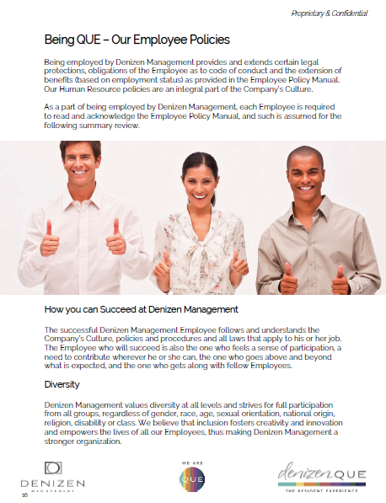
Being OUE – Our Employee Policies
Being employed by Denizen Management provides and extends certain legal protections, obligations of the Employee as to code of conduct and the extension of benefits.
Notes:
Our Human Resource policies are an integral part of the Company’s Culture.
As a part of being employed by Denizen Management, each Employee is required to read and acknowledge the Employee Policy Manual, and such is assumed for the following summary review.

Slide 13
How you can Succeed at Denizen Management?
The Employee who will succeed is also the one who feels a sense of participation, a need to contribute wherever he or she can, the one who goes above and beyond what is expected, and the one who gets along with fellow Employees.
Notes:
The successful Denizen Management Employee follows and understands the Company’s Culture, policies and procedures and all laws that apply to his or her job. The Employee who will succeed is also the one who feels a sense of participation, a need to contribute wherever he or she can, the one who goes above and beyond what is expected, and the one who gets along with fellow Employees.

Slide 14
Diversity
Denizen Management values diversity at all levels and strives for full participation from all groups, regardless of gender, race, age, sexual orientation, national origin, religion, disability or class.
We believe that inclusion fosters creativity and innovation and empowers the lives of all our Employees.

Slide 15
Relationship between Denizen Management & Managepoint
Denizen Management and Managepoint, have entered into a co-employment relationship providing our Employees access to a full menu of high quality human resources, benefits and payroll services.
Notes:
For Human Resource questions regarding policies and procedures, an Employee should first (1) reference this Employee Policy Manual, then (2) their direct Supervisor, who can accordingly reach out to (3) Human Resources.

Slide 16
Employment Policies
The following are a list of those laws and requirements for which each Employee must abide as provided in detail in the Employee Policy Manual.

Slide 17
General Employment Policies
Open door Policy
Conflicts of Interest
Personal Relationships in the Workplace
Business Ethics & Conflict
Safety
Work Related injuries
Substance Abuse
*refer to pages 18-24 for explanation
Evaluations
Internal job postings
Job Descriptions
Pay & Hours
Time Off Benefits (new)
Employee Benefit Plans
Employee Conduct
Electronic Information Policy
Proprietary & Confidential

Slide 18
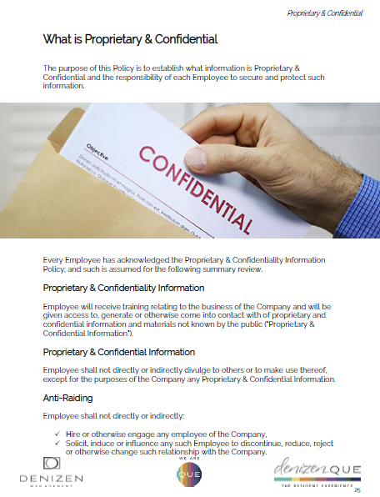
What is Proprietary & Confidential?
During the course of your employment, you will have access to information that the general public does not, such as reports and operating forms. This type of information must remain confidential. No Employee may directly or indirectly divulge such information.
Notes:
During the course of your employment you will have access to information that the general public does not, such as reports and operating forms. This type of information must remain confidential. No Employee may directly or indirectly divulge such information.

Slide 19
Understanding the Electronic Information Policy
Confidentiality – All messages, documents and files created, sent received or stored on the system are the sole property of the Company.
Security – Employees are responsible for maintaining System security relating to company emails, software downloads, company owned equipment, electronic devices, etc.
Company Email - Employees are not to delete any e-mails on the Company System except for Spam/Junk Mail
Social Media – All social media sites intended for business use and are the Property of the Company
Employees are allowed moderate personal use of electronics but must be compliant with DM policies.
Notes:
The Electronic Information Policy (“Policy”) applies to all Employees, contractors and visitors at any Denizen Management (“Company”) location. This Policy refers to all Company owned or leased information systems, including computers, office phones, IP Phones, voicemail, servers, intranet, Internet and e-mail access and electronic devices and data storage media such as PDAs, disks, CD-ROMs and USB drives (“Systems”).

Slide 20
QUE Tools
Employee Resources & Links
The Virtual Time Clock
Managepoint – The Employee Portal
Rent Manager
Training Modules
Continued Education – RM University

Slide 21
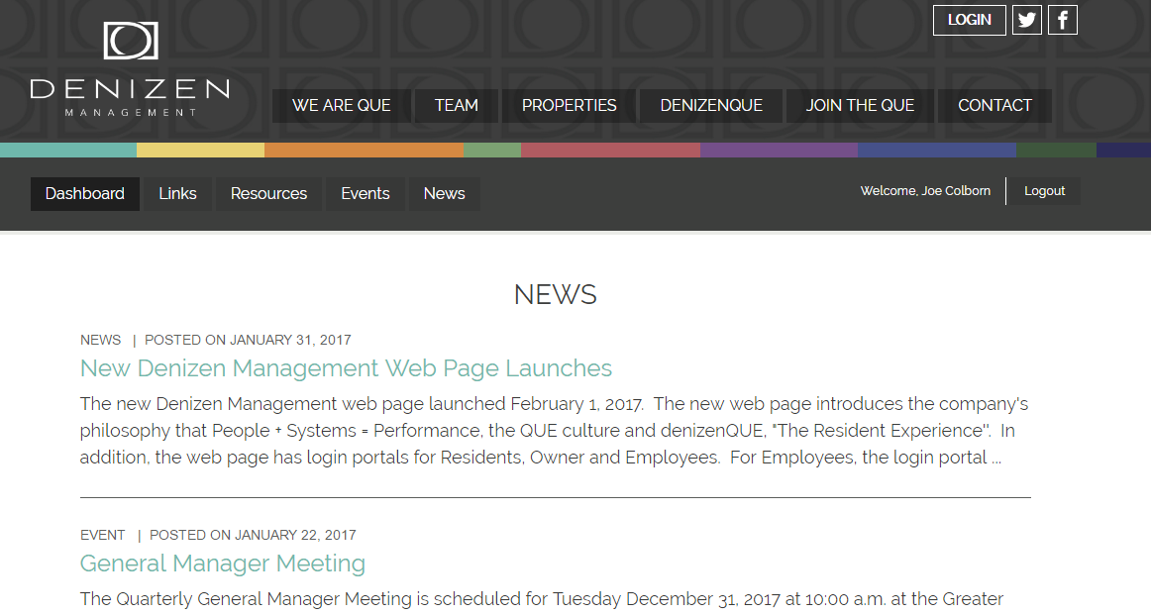
Employee Resources & Links
Go to www.denizenmanagement.com
Notes:
Pgs 32-33

Slide 22
The Virtual Time Clock Nova Time
Clock in and out of work
Keep track of hours worked
View available and request PTO
See your work schedules history, including previous days missed and late punches
Your Employee Number is sent to your Denizen Email
And much more!
Notes:
Pg34-34 for directions

Slide 23
Managepoint The Employee Portal
Payroll related information such as pay stubs, forms (such as direct deposit and tax forms)
View and update personal contact information.
Look for login information on your Denizen email
Notes:
Pgs 36-37

Slide 24
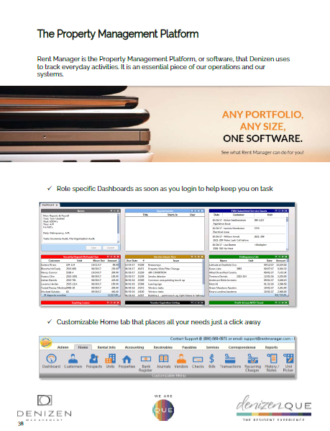
Rent Manager
Our Property Management Software for rent collection, accounts receivable, reporting and much more.
If applicable, log on information is accessed from Denizen Management email
Notes:
Property Management Platform, or software, that Denizen uses to track everyday activities. It is an essential piece of our operations and our systems.
Pgs 38-39

Slide 25
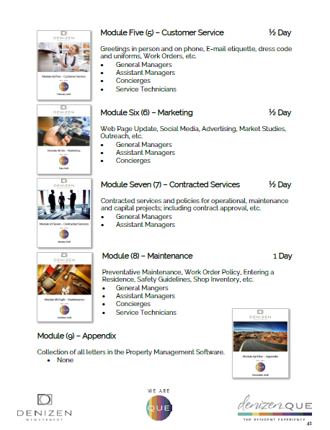
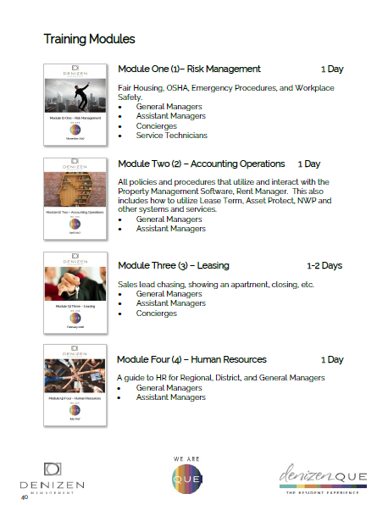
Training Modules
Informs New Hire of the training modules that they will be expected to attend. The scheduling of these Mandatory Modules with be done through QUE Training & Development.

Slide 26
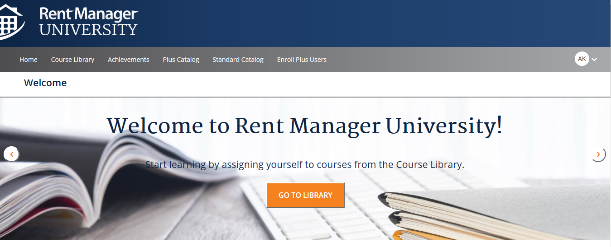
Continued Education
Rent Manager University is the center for continuing education and is brought to you through Rent Manager University.
Notes:
Set up before hire date – you will get an email on DM email Mgr, Asst Mgr and Leasing

Slide 27
Dress, Grooming & Hygiene Policy
During business operations or when representing Denizen Management, Employees are expected to present a clean, neat, and tasteful appearance according to the Dress, Grooming & Hygiene Policy.
Notes:
As provided in the Employee Policy Manual, each Division will establish when Employees are to dressed Business Casual, Service Technician Uniform or Business Professional, but in all cases, must meet all the grooming and hygiene standards.

Slide 28
Business Casual
Not Permitted
Permitted
Please see page 54 of your QUE 101 book for a complete reference of business casual guidelines

Slide 29
Business Professional
Business suit, or dress suit, with or without a vest
Business formal dress, Dress shirt, Tie, or bow tie, Dress socks or stockings, Dress belt, Dress shoes
Dress shirt and tie (corporate office personnel)

Slide 30
New to QUE
As the newest member of the Team, it may take a little time to get personalized items such as Name Tags and Business Cards.
We will provide QUE Business Cards and New to QUE name tag (if applicable).
Notes:
. Each Property comes stocked with property specific New to QUE materials to help get you settled in until your items arrive. Included will be New to QUE Business Cards with the property email address and a New to QUE Name Tag.

Slide 31
Name Tags
Your Name Tag should be worn whenever you are on the clock

Slide 32
Greetings – The First Impression
In-Person Greeting
Smile
Look directly at the other person’s eyes
Extend your hand for a firm handshake (or elbow bump!)
Notes:
As part of the We Are QUE culture, based in a fundamental caring of others, it begins with being interested in others. So, begin each day and each Greeting as follows:

Slide 33
Phone Greeting
Relax
Smile, show positivity and a good mood
Answer the phone with enthusiasm
Notes:
Incoming Call
“Thank you for calling (property name), my name is Jane (Employee first name), How may I assist you?”
If the caller does not provide you their name, ask “Who do I have the pleasure of speaking with today?”.
Outgoing Calls
“Hello, this is Cody (Employee first name) with (property name)”.
AS a reminder, always log all prospects leads in the PM software with detailed notes

Slide 34
E-mail Etiquette – The Modern Letter
When you send an Email, the content, tone, professionalism and format reflect the reputation of you, the sender and the Company. In your email is where image and reputation are very important.
Notes:
For hundreds of years, mailed business and personal letters were used as the primary means to communicate over a distance. Schools taught formal business letter writing, and in addition to the structure, content and tone, letter formatting was emphasized; all to build and maintain the image and reputation of the business and the sender.
Today, The Modern Letter is Email where image and reputation are still as important, but the mailed letter is all but gone

Slide 35
Email Format
Include the standard Company signature and format.
Keep your fonts classic. Raleway 12 pt. font
Use your Company Email address.

Slide 36
Just as answering the phone is important, so too is proper Email Etiquette and content.
In addition, Emails are often short and are highly susceptible to misinterpretations, so polite, clear and concise Emails are best.
Refer to Pages 56-57

Slide 37
101 Essentials of Fair Housing
Denizen Management strongly believes in the right of every qualified applicant to receive equal access to housing and treatment by our Employees; and is closely tied to our We Are QUE culture, based in a fundamental philosophy of caring for others.

Slide 38
To Start Your Day Team Huddles
Communication is the key to all successful relationships; professional or personal. Many companies with excellent missions, products and services fail due to lack of recognition of the importance to communicate effectively with their Employees; and with one another.
Notes:
Communication is the key to all successful relationships; professional or personal. Many companies with excellent missions, products and services fail due to lack of recognition of the importance to communicate effectively with their Employees; and with one another.

Slide 39
Questions?
Comments?
Concerns?
Thank You!!

