Slide 1
Welcome

Slide 2
How to Manage People
12 Step Program

Slide 3
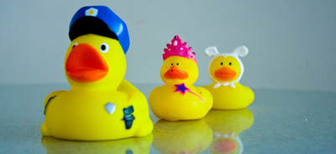
Rid your mind of the word “manager” and replace it with “leader”.
Notes:
Leaders don’t require titles or promotions; they are people that inspire and motivate without regard Lead by example. Treat your employees like you want to be treated.

Slide 4
Keep a Good Sense of Humor
Notes:
It makes you approachable and it helps you maintain perspective. Don't take yourself too seriously. Everyone puts their pants on one leg at a time.

Slide 5
Remember your direct reports are People
Notes:
They are not resources and they are not human capitol. They are people with families, feelings, and problems. It is not possible to separate work from home life. Be aware that people have personal lives and do the best you can to be sensitive to them. Treat everyone as your equal regardless of their title or position. Remember to smile a lot and always maintain a pleasant demeanor.

Slide 6
Know Your Strengths and Weakness.
Notes:
Know the strengths of your team as well as the weakness and allow for improvement. We all have strengths and weaknesses. Learning to recognize them can help your team.

Slide 7
Have a clear plan of what needs to be done
Notes:
“By failing to plan you plan to fail.” Set goals with clear endpoints and rewards for your team. It's also important to lead by example; people want to see that their boss is working hard and is there to support them, not berate them

Slide 8
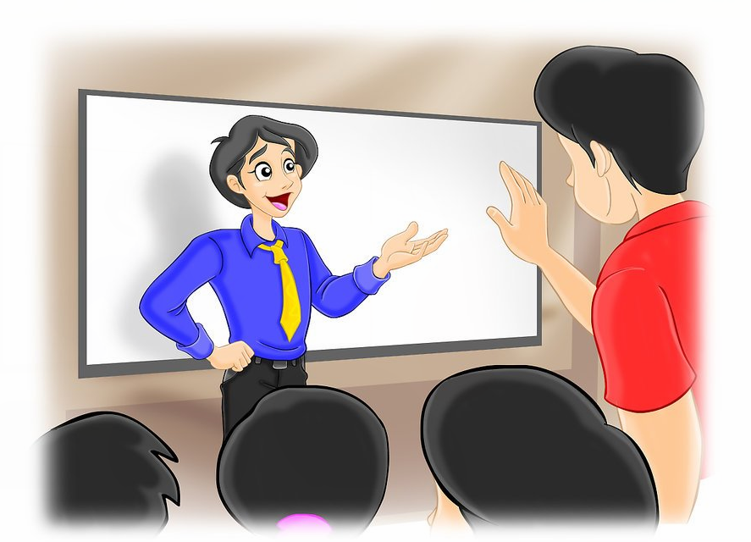
Be Decisive
Notes:
When asked for your opinion, you should have it well thought out and present it persuasively. You should not waffle or stall. For big decisions, set a deadline, and have the decision by that time. If someone offers an argument that convinces you to change a decision, acknowledge it and embrace the new idea completely

Slide 9
Communicate your expectations.
Notes:
Put them in writing whenever possible. Solicit feedback from the people you are leading. Know what they expect from you. Address any discrepancies immediately and clearly. Address issues directly with the individual. Don’t punish the team. Ex: playing games on their computer.

Slide 10
Maintain the confidence of everyone in the organization
Notes:
Managers frequently have access to more information than other employees. It is imperative that you never betray the confidence of the company, your manager, your peers, or your employees. Be sure that people can confide in you.

Slide 11
Be Consistent
Notes:
Your actions and reactions must be consistent. You don’t want to be the type of manager that everyone asks what kind of mood you are in before they approach you with an issue. You also do not want to treat one employee different than another employee. ( nothing will cause conflict more)

Slide 12
Focus on the Positive
Notes:
Try to keep all your conversations with employees positive. If you need to reprimand or go over procedures they are not doing correctly, try to end on a positive note. Focus on solutions not on problems.

Slide 13
Let Your Employees Know You Appreciate Them.
Notes:
Thank your employees everyday, appreciate them and they will always work hard for you. A well-treated and respected employee is a happy employee.

Slide 14
Hire slowly and fire quickly
Notes:
Take your time hiring good quality people. Have several people interview and do thorough background checking Hire good people, treat them right and empower them. But, when you have a disruptive personality or person who fails to perform you need to take all steps to get rid of them as quickly as possible

